Slide 1

Data Analyst Capstone Project Report
Porotikov Egor
25.05.2026

Slide 2



OUTLINE
Executive Summary
Introduction
Methodology
Results
Visualization – Charts
Dashboard
Discussion
Findings & Implications
Conclusion
Appendix

Slide 3

EXECUTIVE SUMMARY
The survey analysis provides insights into developer demographics, technology usage, and future preferences.
Programming Languages: JavaScript, Python, TypeScript, and HTML/CSS dominate both current usage and future interest.
Databases: PostgreSQL leads in both experience and demand, followed by MySQL, Redis, and SQLite.
Platforms: AWS remains the most widely used and most desired cloud platform.
Web Frameworks: React, Express, and ASP.NET Core show the strongest presence across both dashboards.
Demographics: Most respondents are between 25–34 years old, with the majority holding Bachelor’s or Master’s degrees.
Global Distribution: Responses come from a wide range of countries, with strong representation from the US and Europe.

Slide 4

INTRODUCTION
This project analyses developer survey data to understand global trends in technology usage, preferences, and demographics.
The dataset includes information on programming languages, databases, platforms, web frameworks, and respondent background characteristics.
The goal of the analysis is to identify the most used technologies today and the technologies developers want to get in the future.
The project also explores demographic patterns such as age distribution, education levels, and geographic representation.
These insights help highlight how developer experience and preferences vary across different groups.
The dashboards provide a clear visual summary of key findings.

Slide 5

METHODOLOGY
The analysis is based on the survey_data_updated.csv dataset containing developer responses from many countries.
Data was imported into IBM Cognos Analytics for cleaning, transformation, and visualization.
Key preprocessing steps included:
Removing missing or invalid entries where necessary.
Splitting fields (e.g., languages, databases, platforms) into separate rows for accurate counting.
Creating cleaned datasets for each technology category.
Dashboards were developed to explore:
Current technology usage (Languages, Databases, Platforms, Web Frameworks).
Future technology preferences (technologies respondents want to work with).
Demographic patterns (Age, Country, Education Level).
Visualizations were selected to best represent each metric, including bar charts, pie charts, maps, treemaps, line charts, and stacked bar charts.

Slide 6
Results
The following slides present the key findings from the analysis, including technology usage trends, future preferences, and demographic insights as well as key insights from Job posting from different countries.

Slide 7
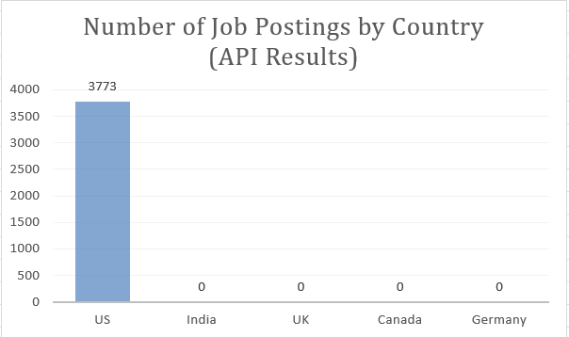
JOB POSTINGS
In Module 1 you have collected the job posting data using Job API in a file named “job-postings.xlsx”. Present that data using a bar chart here. Order the bar chart in the descending order of the number of job postings.

Slide 8
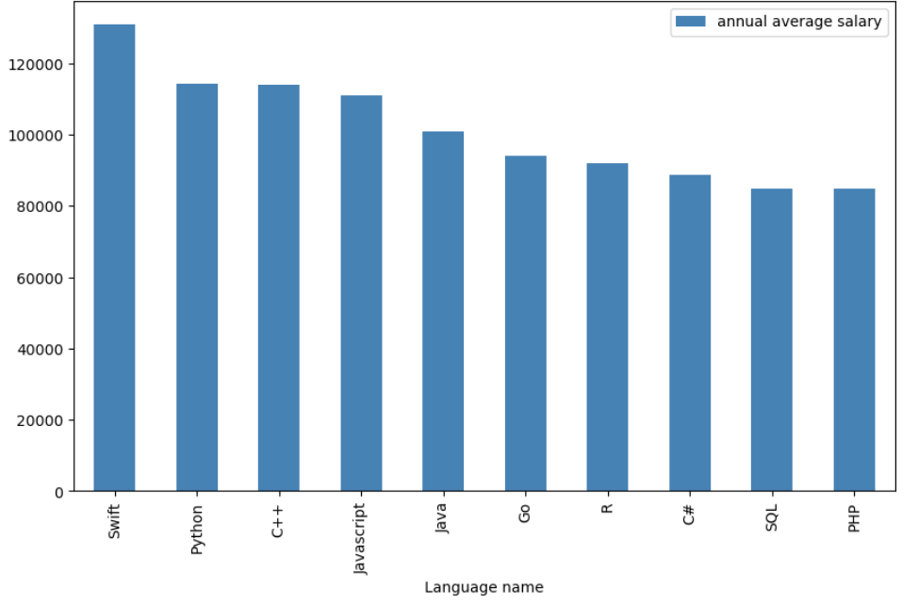
POPULAR LANGUAGES
In Module 1 you have collected the job postings data using web scraping in a file named “popular-languages.csv”. Present that data using a bar chart here. Order the bar chart in the descending order of salary.

Slide 9
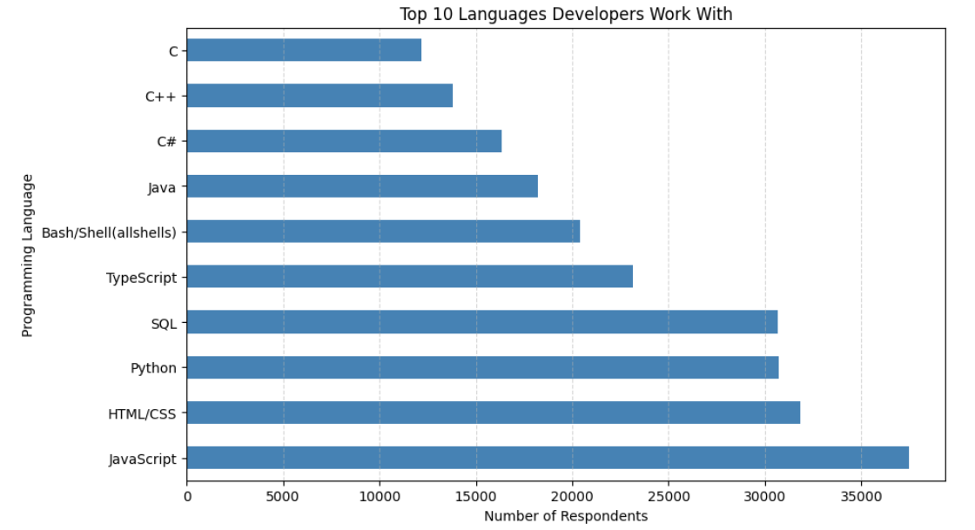
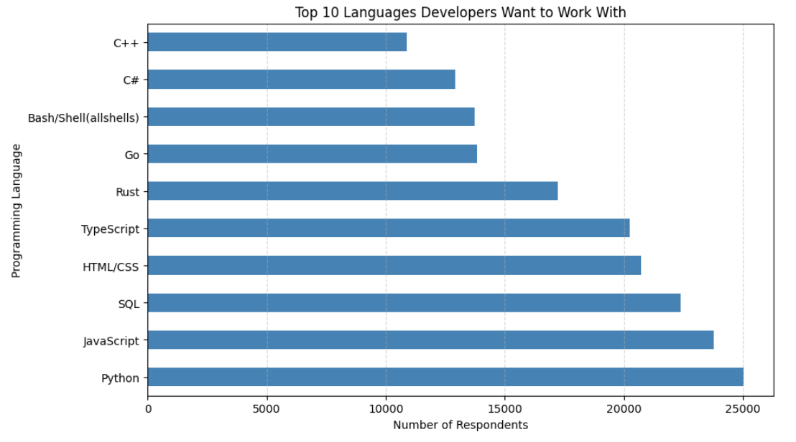
PROGRAMMING LANGUAGE TRENDS
Current Year
Next Year
<Bar chart of top 10 programming languages for the current year goes here.>
< Bar chart of top 10 programming languages for the next year goes here.>

Slide 10
PROGRAMMING LANGUAGE TRENDS - FINDINGS & IMPLICATIONS
Implications
Python is becoming the most desirable language for future learning and projects, showing its versatility and strong industry demand.
JavaScript and HTML/CSS remain popular because of their importance in web development.
SQL continues to be essential for data work, confirming the stable demand for database and analytics skills.
Some new programming languages interested some developers, but they will not have much popularity.
Findings
Python, JavaScript, HTML/CSS, and SQL continue to dominate as the most commonly used languages.
For next year, Python becomes the most preferred language, surpassing JavaScript.
Interest in Rust and Go is growing, but they are still smaller compared to the major languages.

Slide 11
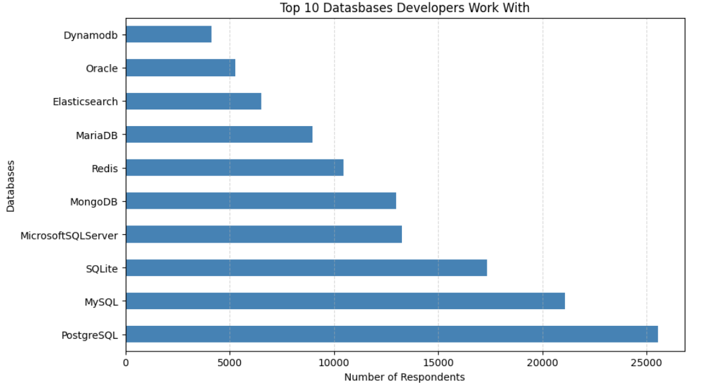
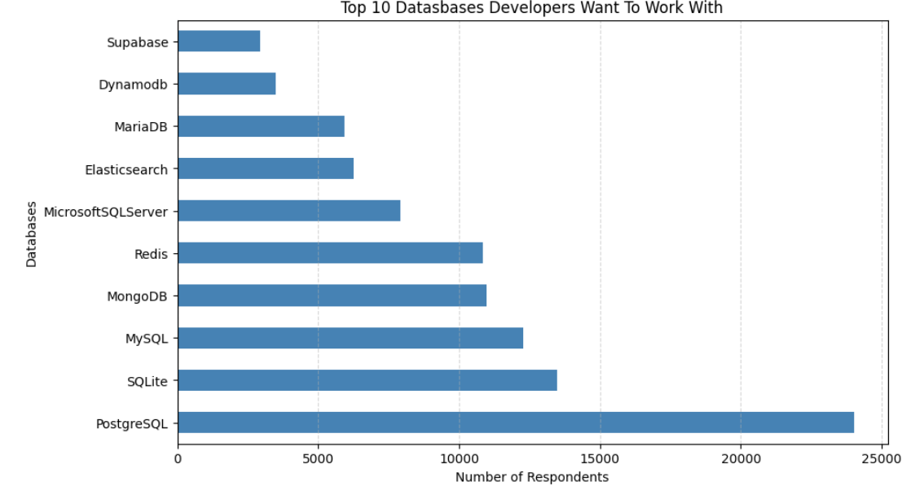
DATABASE TRENDS
Current Year
Next Year

Slide 12
DATABASE TRENDS - FINDINGS & IMPLICATIONS
Findings
The trends show that PostgreSQL, MySQL, and SQLite continue to dominate both current usage and future preferences.
Some databases become less popular next year, especially Oracle, which almost disappears from developers’ future choices.
The overall ranking remains stable, with only small shifts in interest for emerging tools like Supabase
Implications
PostgreSQL, MySQL, and SQLite remain the top databases in both current usage and future preferences.
Oracle significantly drops in popularity and almost disappears from developers’ future choices.
Supabase appears as a perspective option, but still with low spread.

Slide 13

DASHBOARD
The following slides present the interactive dashboards created from the survey data, including technology trends and demographic insights

Slide 14
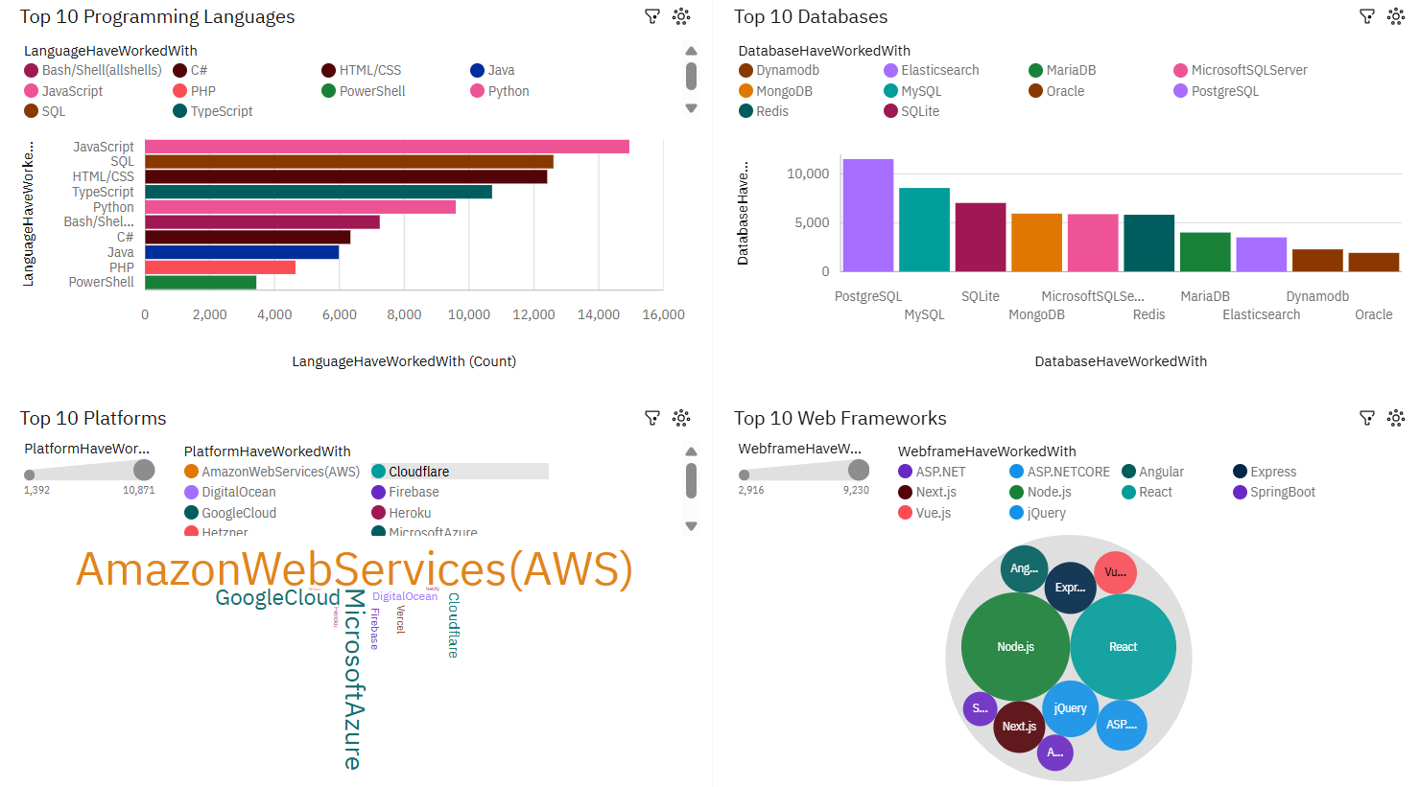
DASHBOARD TAB 1: Current Technology Usage

Slide 15
Dashboard Insight
The dashboards highlight the dominant technologies across all categories, showing trends in programming languages, databases, platforms, and web frameworks.
Python, JavaScript, HTML/CSS, and SQL remain the core languages developers rely on.
PostgreSQL, MySQL, and SQLite continue to lead database usage, while Oracle shows a clear decline.
AWS is the primary cloud platform, and Node.js with React dominate in the web framework field.

Slide 16
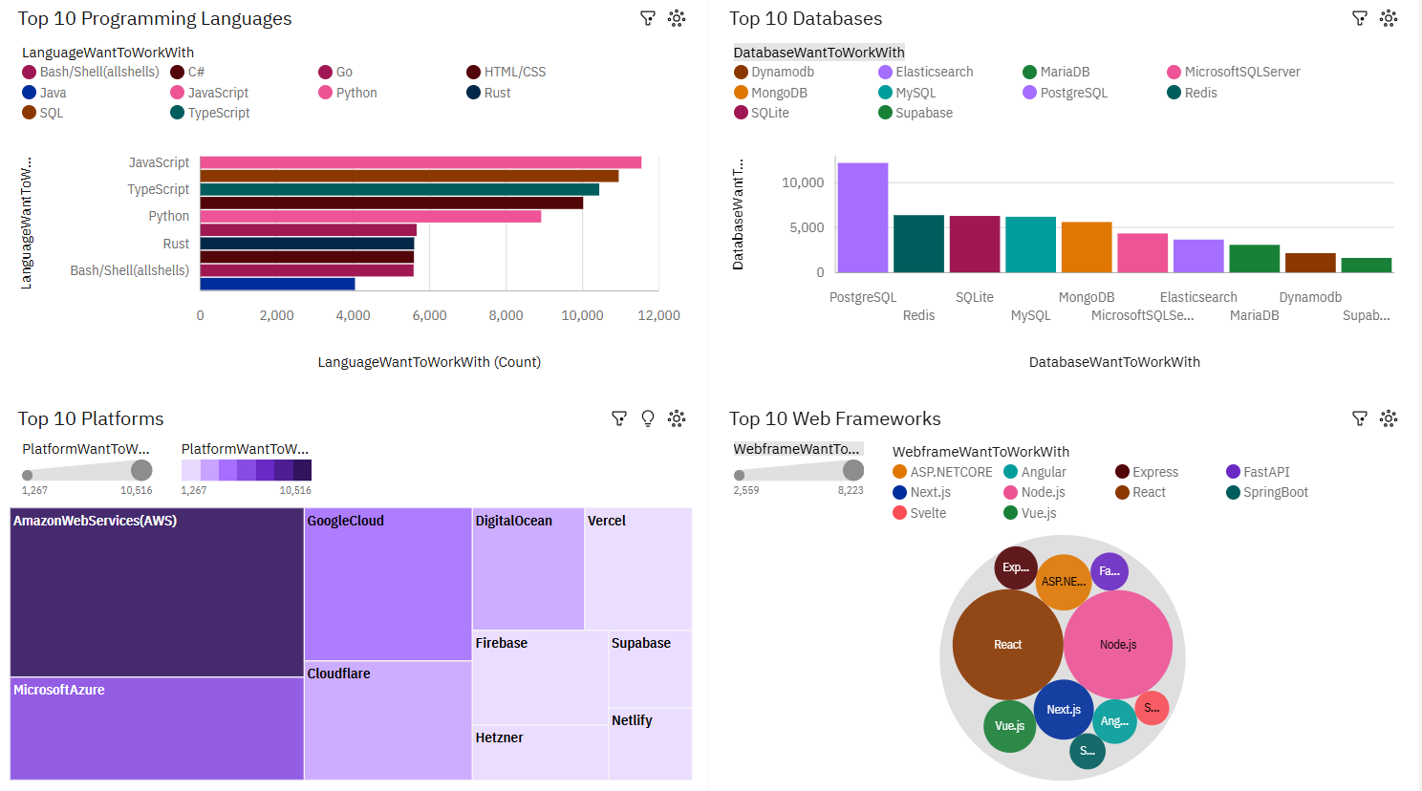
DASHBOARD TAB 2: Future Technology Trends

Slide 17
Dashboard Insight
The overall trends remain consistent with the previous dashboard: the same core technologies dominate across all categories.
Programming Languages: JavaScript, TypeScript, and Python remain the top choices developers want to work with, with Rust gaining noticeable interest.
Databases: PostgreSQL continues to lead by a large part of users, while Redis and SQLite show strong future demand.
Platforms: AWS remains the most preferred cloud platform, followed by Google Cloud and Azure, confirming the stability of cloud ecosystem trends.
Web Frameworks: React and Node.js continue to dominate developer preferences, with Next.js and Vue.js also showing strong interest.

Slide 18
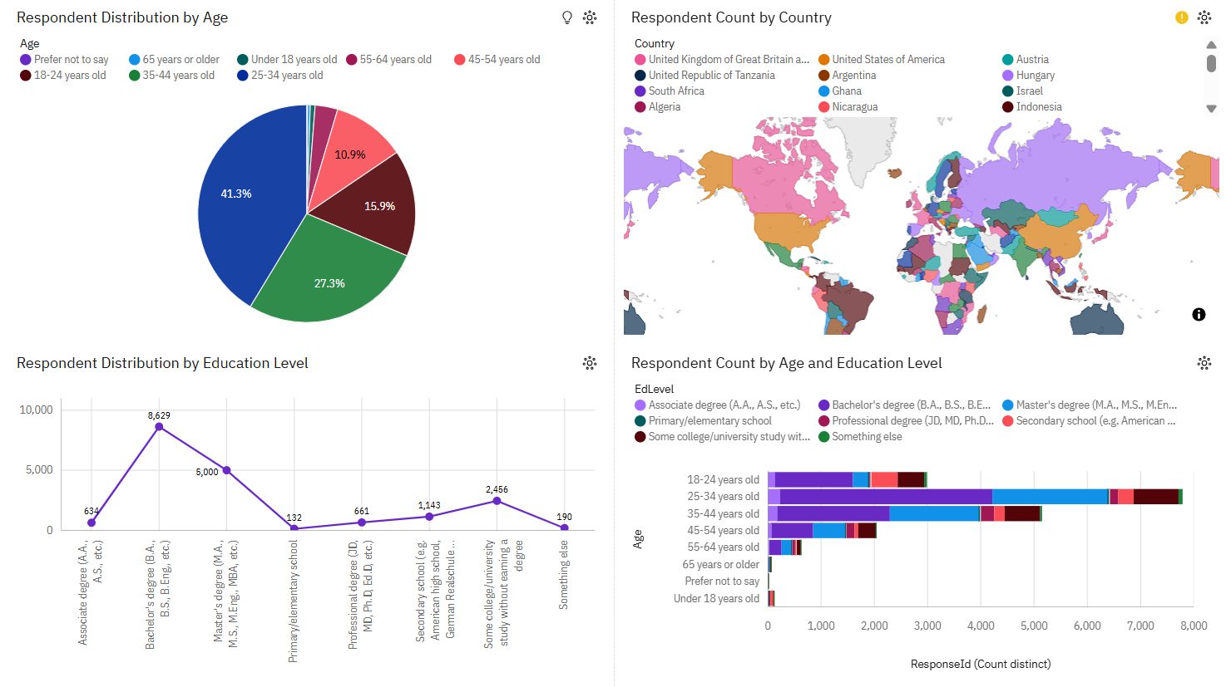
DASHBOARD TAB 3: Demographics

Slide 19
Dashboard Insight
The majority of respondents are between 25–34 years old, making it the dominant age group in the survey.
Most participants hold a Bachelor’s degree, followed by Master’s degree holders, showing a generally well‑educated developer population.
The geographic distribution is around Europe and North America, which together represent the largest share of respondents.
The combined demographic patterns indicate that the survey mainly reflects the perspectives of young, highly educated developers from West Europe and North America.

Slide 20
DISCUSSION
The dashboards show that technology trends across programming languages, databases, platforms, and web frameworks are highly stable. The same core technologies dominate both current usage and future preferences, indicating a stable and consistent developer ecosystem.
Python, JavaScript, SQL, and HTML/CSS remain central skills, while PostgreSQL, MySQL, and SQLite continue to lead the database landscape. AWS is the primary cloud platform, React and Node.js remain big share in web development.
Demographic insights reveal that the survey mainly represents young, educated developers from Europe and North America. Overall, the dashboards highlight a technology environment where established tools maintain their leadership, while emerging technologies like Rust, Go, and Supabase show early but growing interest.

Slide 21
OVERALL FINDINGS & IMPLICATIONS
Findings
Core technologies (Python, JavaScript, SQL, PostgreSQL, AWS, React/Node.js) dominate across all dashboards.
Future preferences closely mirror current usage, showing stable longterm trends.
Demographics show a young, well‑educated, Europe and North America developer population.
Implications
The tech ecosystem is mature and stable, with established tools remaining highly relevant.
Growth in modern tools (Rust, Go, Supabase) suggests gradual innovation but not major shifts yet.
Insights mainly reflect trends within Western developer communities, influencing which technologies appear dominant.

Slide 22

CONCLUSION
The analysis shows a clear and consistent technology landscape, where established tools continue to lead and future preferences confirm these patterns.
Across all dashboards, the stability of trends suggests that developers rely on a mature, well‑defined ecosystem with only gradual shifts toward newer technologies.
Overall, the dashboards provide a clear understanding of current and future tech directions.

Slide 23

APPENDIX
Include any relevant additional charts, or tables that you may have created during the analysis phase.

